Slide 1

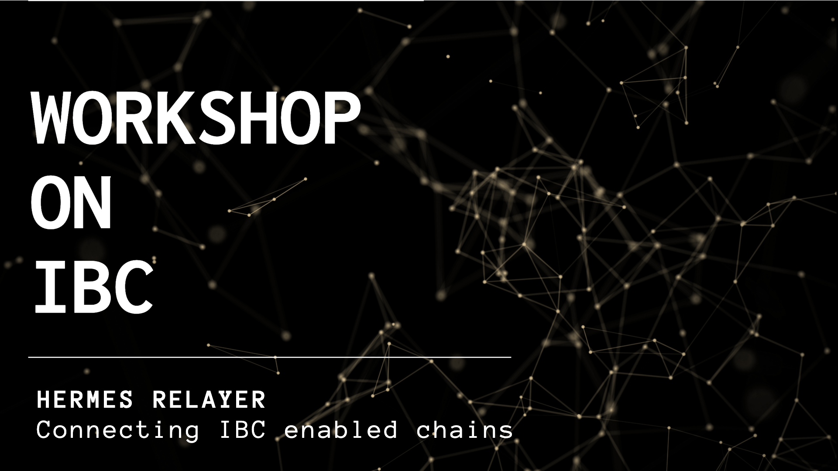

Slide 2



Andy Nogueira
andynog
andynogdev

Slide 3


Who We Are
We envision an open-source ecosystem of cooperatively owned and governed distributed organizations running on reliable distributed systems.
https://informal.systems

Slide 4
Agenda
Why IBC ?
IBC
Demo
Q&A

Slide 5
Workshop
github.com/informalsystems/hermes-ibc-workshop

Slide 6
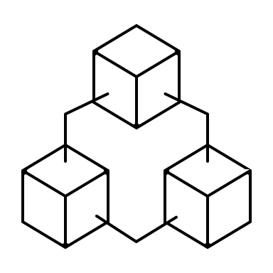

Distributed Ledger A
Distributed Ledger B
Sovereign
Sovereign
Consensus
Consensus
State Machine
State Machine
Notes:
IBC provides a mechanism by which separate, sovereign replicated ledgers can safely, volutarily Interact while sharing only a minimum common interface

Slide 7

Token A
Distributed Ledger A
Distributed Ledger B
Notes:
IBC provides a mechanism by which separate, sovereign replicated ledgers can safely, volutarily Interact while sharing only a minimum common interface

Slide 8

Distributed Ledger A
Distributed Ledger B
Notes:
IBC provides a mechanism by which separate, sovereign replicated ledgers can safely, volutarily Interact while sharing only a minimum common interface

Slide 9
Distributed Ledger A
Distributed Ledger B
Notes:
IBC provides a mechanism by which separate, sovereign replicated ledgers can safely, voluntarily Interact while sharing only a minimum common interface

Slide 10




Distributed Ledger A
Distributed Ledger B
Notes:
IBC provides a mechanism by which separate, sovereign replicated ledgers can safely, voluntarily Interact while sharing only a minimum common interface

Slide 11



Distributed Ledger A
Distributed Ledger B
Notes:
IBC provides a mechanism by which separate, sovereign replicated ledgers can safely, voluntarily Interact while sharing only a minimum common interface

Slide 12
Distributed Ledger A
Distributed Ledger B
Notes:
IBC provides a mechanism by which separate, sovereign replicated ledgers can safely, voluntarily Interact while sharing only a minimum common interface

Slide 13

Distributed Ledger A
Distributed Ledger B
Notes:
IBC provides a mechanism by which separate, sovereign replicated ledgers can safely, voluntarily Interact while sharing only a minimum common interface

Slide 14

Distributed Ledger A
Distributed Ledger B
Notes:
IBC provides a mechanism by which separate, sovereign replicated ledgers can safely, voluntarily Interact while sharing only a minimum common interface

Slide 15
Distributed Ledger A
Distributed Ledger B
Notes:
IBC provides a mechanism by which separate, sovereign replicated ledgers can safely, voluntarily Interact while sharing only a minimum common interface

Slide 16
Distributed Ledger A
Distributed Ledger B
Notes:
IBC provides a mechanism by which separate, sovereign replicated ledgers can safely, voluntarily Interact while sharing only a minimum common interface

Slide 17

Distributed Ledger A
Distributed Ledger B
Notes:
IBC provides a mechanism by which separate, sovereign replicated ledgers can safely, voluntarily Interact while sharing only a minimum common interface

Slide 18
Distributed Ledger A
Distributed Ledger B
Notes:
IBC provides a mechanism by which separate, sovereign replicated ledgers can safely, voluntarily Interact while sharing only a minimum common interface

Slide 19


Distributed Ledger A
Distributed Ledger B
Notes:
IBC provides a mechanism by which separate, sovereign replicated ledgers can safely, voluntarily Interact while sharing only a minimum common interface

Slide 20

Distributed Ledger A
Distributed Ledger B
Notes:
IBC provides a mechanism by which separate, sovereign replicated ledgers can safely, voluntarily Interact while sharing only a minimum common interface

Slide 21
Distributed Ledger A
Distributed Ledger B
Notes:
IBC provides a mechanism by which separate, sovereign replicated ledgers can safely, voluntarily Interact while sharing only a minimum common interface

Slide 22
Distributed Ledger A
Distributed Ledger B
Notes:
IBC provides a mechanism by which separate, sovereign replicated ledgers can safely, voluntarily Interact while sharing only a minimum common interface

Slide 23
Distributed Ledger A
Distributed Ledger B
Notes:
IBC provides a mechanism by which separate, sovereign replicated ledgers can safely, voluntarily Interact while sharing only a minimum common interface

Slide 24


Notes:
IBC provides a mechanism by which separate, sovereign replicated ledgers can safely, voluntarily Interact while sharing only a minimum common interface

Slide 25
Notes:
IBC provides a mechanism by which separate, sovereign replicated ledgers can safely, voluntarily Interact while sharing only a minimum common interface

Slide 26
Notes:
IBC provides a mechanism by which separate, sovereign replicated ledgers can safely, voluntarily Interact while sharing only a minimum common interface

Slide 27
Notes:
IBC provides a mechanism by which separate, sovereign replicated ledgers can safely, voluntarily Interact while sharing only a minimum common interface

Slide 28





light client
ledger A
light client
ledger B
Distributed Ledger A
Hermes Relayer
Distributed Ledger B
Notes:
IBC provides a mechanism by which separate, sovereign replicated ledgers can safely, voluntarily Interact while sharing only a minimum common interface

Slide 29

IBC

Slide 30
IBC =
Interblockchain
Communication
Protocol

Slide 31



Interchain Standard IBC / TAO
Transport
Authetication
Ordering Layer

Slide 32

ics-2
ics-3
ics-4
Client Semantics
Connection Semantics
Channel & Packet Semantics
ics-5
Port Allocation
ics-6
Solo Machine Client
ics-7
ics-9
Loopback Client
Tendermint Client
ics-10
GRANPA Client
IBC TAO
ics-18
Relayer Algorithms
ics-23
Vector Commitments
ics-24
Host Requirements
ics-25
Handler Interface
ics-26
Router Module
https://github.com/cosmos/ics

Slide 33
ics-2
ics-3
ics-4
Client Semantics
Connection Semantics
Channel & Packet Semantics
ics-5
Port Allocation
ics-6
Solo Machine Client
ics-7
ics-9
Loopback Client
Tendermint Client
ics-10
GRANPA Client
IBC TAO
ics-18
Relayer Algorithms
ics-23
Vector Commitments
ics-24
Host Requirements
ics-25
Handler Interface
ics-26
Router Module
https://github.com/cosmos/ics

Slide 34


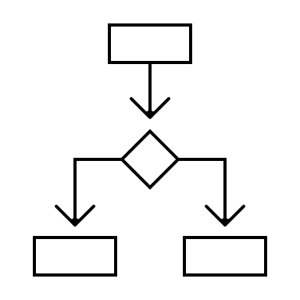
Interchain Standard IBC / APP
Application Layer
Packet Enconding
Processing Semantics

Slide 35
ics-20
ics-27
Fungible Token Transfer
Interchain Accounts
IBC APP
https://github.com/cosmos/ics

Slide 36
ics-20
ics-27
Fungible Token Transfer
Interchain Accounts
IBC APP
https://github.com/cosmos/ics

Slide 37
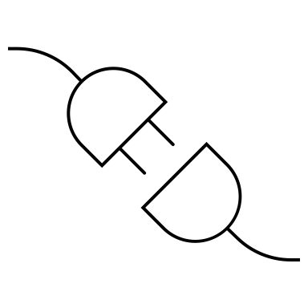
Clients

Slide 38


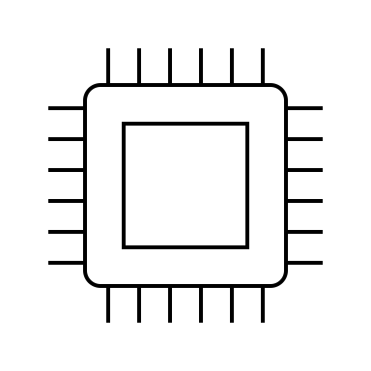
Chain A
Relayer
Chain B
Light client A
Light client B
Client
Client
create_client
update_client

Slide 39

Connection
Handshake

Slide 40
Chain A
Relayer
Chain B
Light client A
Light client B
Client
Client
Connection
Connection
OPEN
OPEN
conn_open_init
conn_open_try
conn_open_ack
conn_open_confirm

Slide 41

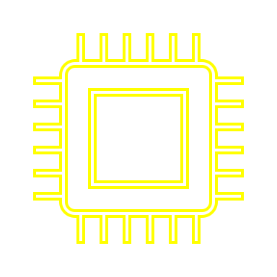
Prior State
Posterior State
CONN_OPEN_INIT
[NONE, NONE]
[INIT, NONE]
CHAIN A
CONN_OPEN_TRY
[INIT, NONE]
CHAIN B
[INIT, TRYOPEN]
CONN_OPEN_ACK
[INIT, TRYOPEN]
CHAIN A
[OPEN, TRYOPEN]
CONN_OPEN_CONFIRM
[OPEN, TRYOPEN]
CHAIN B
[OPEN, OPEN]

Slide 42
Channel
Handshake

Slide 43
Chain A
Relayer
Chain B
Light client A
Light client B
Client
Client
Connection
Connection
OPEN
OPEN
channel_open_init
Channel
channel_open_try
Channel
OPEN
channel_open_ack
OPEN
channel_open_confirm

Slide 44
Prior State
Posterior State
CHANNEL_OPEN_INIT
[NONE, NONE]
[INIT, NONE]
CHAIN A
CHANNEL_OPEN_TRY
[INIT, NONE]
CHAIN B
[INIT, TRYOPEN]
CHANNEL_OPEN_ACK
[INIT, TRYOPEN]
CHAIN A
[OPEN, TRYOPEN]
CHANNEL_OPEN_CONFIRM
[OPEN, TRYOPEN]
CHAIN B
[OPEN, OPEN]

Slide 45

Packets

Slide 46

Chain A
Relayer
Chain B
Light client A
Light client B
Client
Client
Connection
Connection
OPEN
OPEN
send_packet
Channel
receive_packet
Channel
OPEN
OPEN
ack_packet
timeout_packet

Slide 47

Q&A

Slide 48
Спасибо

